Slide 1
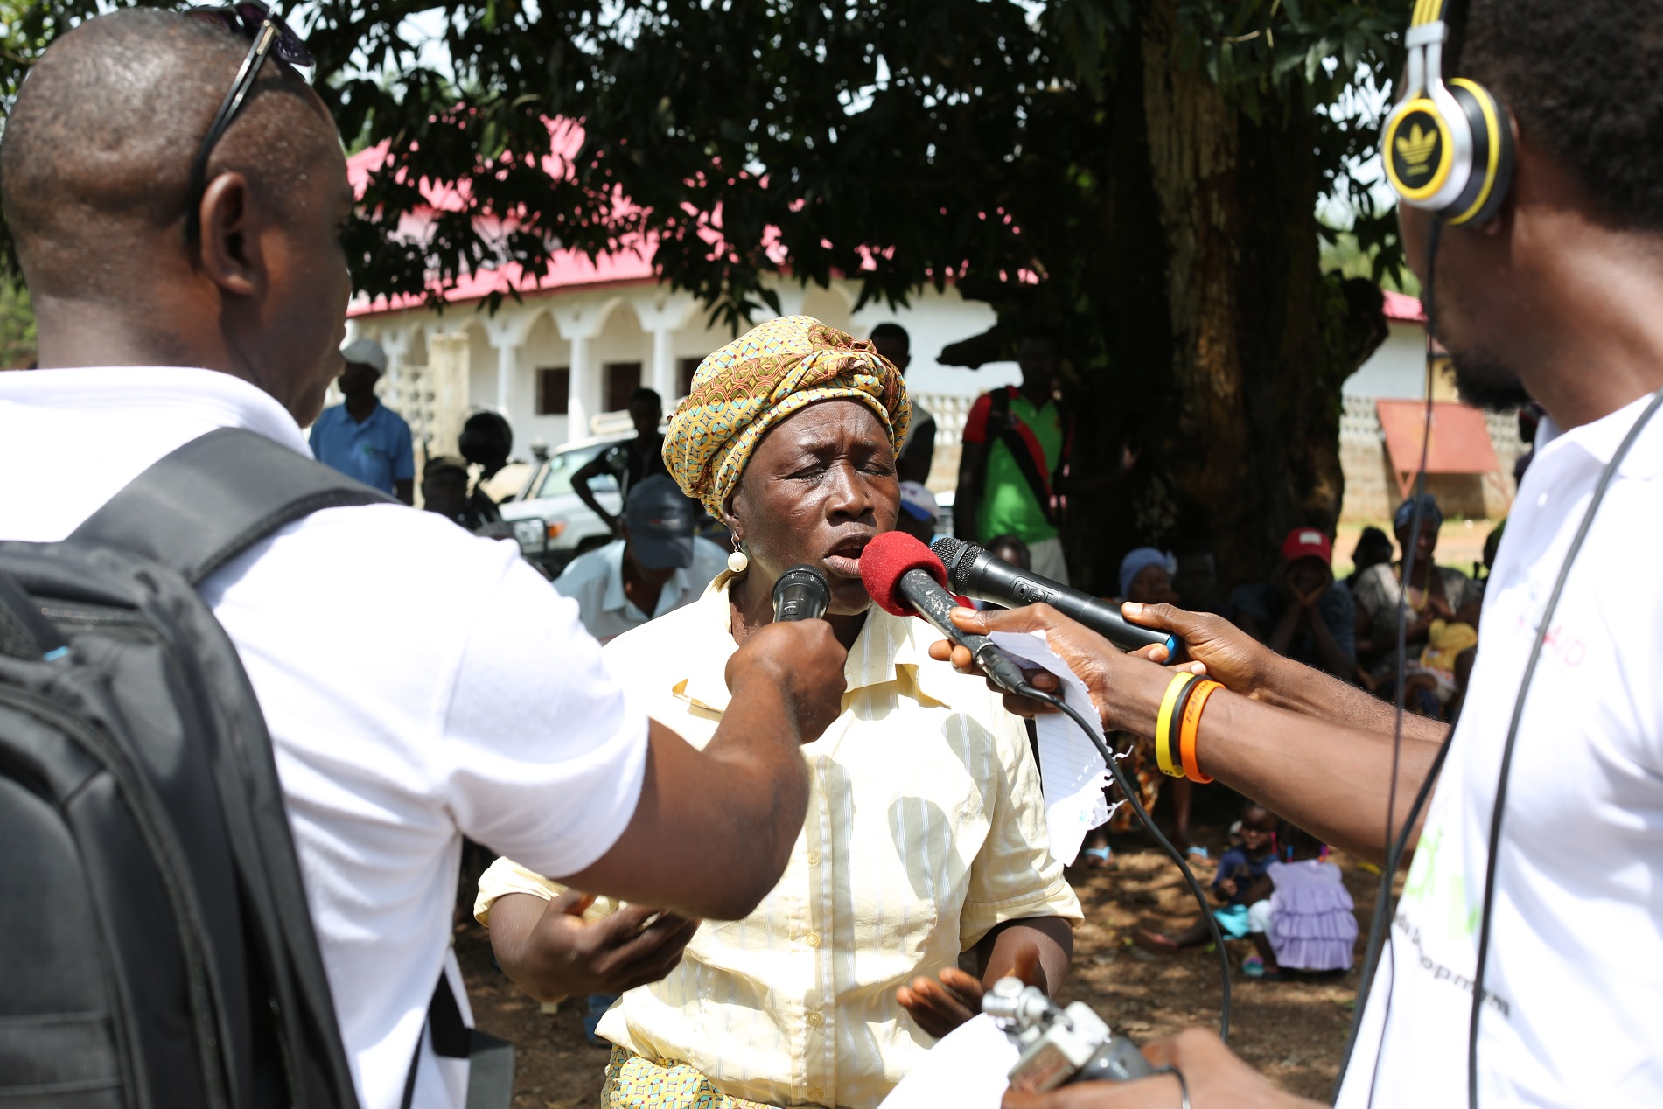



The Role of Media in Strengthening Health Governance: A review of project interventions

Slide 2
Background
The Strengthening Post-Ebola Health Governance programme strived to create greater monitoring, accountability and citizens engagement on Health Governance issues. Output 3 of the project focuses on “Increasing media capacity in Sierra Leone to monitor and oversee health care services” and capitalises on the complimentary role of the media in galvanizing citizens voices and giving them a platform to express their views and opinions on access to the Free Health Care drugs and services.

Slide 3
First Phase
In the first year of the project (October 2017 – September 2018), a total of 152 journalists were trained on Health Governance and Accountability and these formed the Health Accountability Network of Journalists (HANoJ)
30 community radio stations across the country and 75 radio programmes on Health Governance and Accountability were produced and broadcast. All of these programs remain accessible on the IMdev website http://www.IMdev.media/ and on the sound cloud link https://soundcloud.com/user-445663626.

Slide 4
Second phase
The second phase aimed at building the capacity of the media and citizens to improve the accountability of health service delivery, with a focus on drug and medical equipment distribution (including free health care, malaria and nutrition supplies), and (using the media) engage communities and health stakeholders at both the national and local levels and civil society.
Continue supporting local radio platforms to share information on health services and health sector reform, raise awareness about rights and the benefits of health services, and provides feedback on the quality of health services.
Promoting a collective platform for education, information and facilitating citizens’ engagement with government towards building strong systems of accountability and transparency in the health sector.
This phase was supported in October 2019 and wrapped up on August 15 2020

Slide 5

Interventions
From October 2019 to August 2020, the project focused on the reengagement of community radios, the Health Accountability Network of Journalists and Listener clubs.
The project also enhanced its visibility in communities through its outdoor broadcasts and increased local and national radio programs on Health Governance and Accountability, which addressed issues of citizens engagement and access to the Free Health Care drugs by promoting greater transparency, accountability on health duty bearers and stakeholders
IMdev also established more linkages and build synergies with the other components of the project (VDCs, U Reporters, civil society) to generate content and to ensure more stakeholder participation for the radio programs.

Slide 6
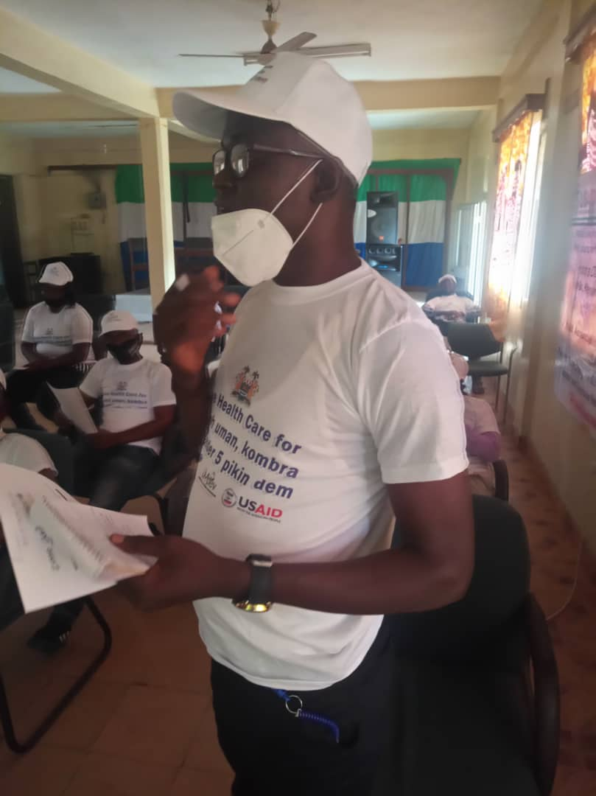
Interventions
IMdev also took into consideration lessons learnt in the first year of the project to enhance engagement, visibility and participation by health stakeholders, Health for All Coalition, local councils, Ministry of Health and Sanitation and other stakeholder participation for impactful outcomes.
Throughout program implementation, in all radio program productions and broadcasts, the contributions of USAID and UNICEF were recognised. IMdev also prioritised gender mainstreaming in all programming.

Slide 7
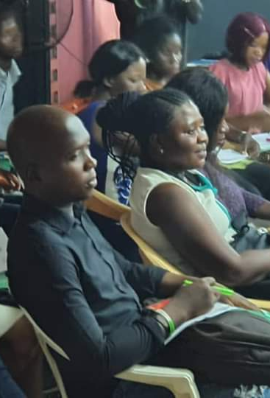
HEALTH ACCOUNTABILITY NETWORK OF JOURNALISTS (HANoJ)
152 journalists were trained during the period of reporting out of the targeted 150. These refresher trainings took place in the Freetown, Makeni, Bo and Kenema cities respectively covering all of the regions of the country.
https://drive.google.com/drive/folders/1RzQf6ZP7FR2TeL65_6_3EOz1D1ATlrJj
the capacity of the media to improve the accountability of health service delivery and the responsibility of the media to engage communities, civil society and health stakeholders at both the national and local levels. The topics ranged from identifying instruments for increasing accountability , social media journalism, citizen participation and inclusive governance and human rights reporting amongst others.

Slide 8
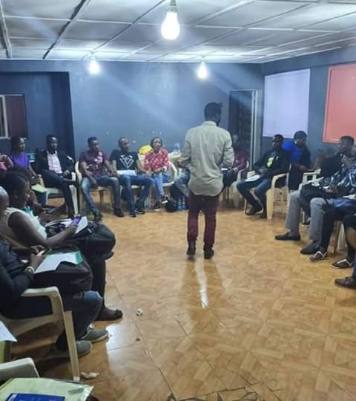
HEALTH ACCOUNTABILITY NETWORK OF JOURNALISTS (HANoJ)
Following the refresher training, each region (North/NorthWest, East, South , West) held two physical meetings at regional levels to reflect on interventions, lessons learnt and discuss story ideas on health accountability.
IMdev mentorship coordinator kept in touch with these journalists via regional WhatsApp group and telephone calls. Journalists received direct mentorship throughout the life cycle of the project on high impact stories and quality.
The network attended DHMT meetings at district levels, reported on last mile distributions, participated in council meetings and continually engaged on health accountability in their respective communities.
Stories pitched to the mentorship coordinator showed great improvement in the format, tone and representation. The journalists were able to explore innovative ideas which created a different approach to accountability in journalism on work that encompasses, fact checking, data journalism and investigative reporting, but more generally applying to health accountability.
https://drive.google.com/drive/folders/1W5sfM2qYNSxprPTgtL7vWTJq2pjdx8UE

Slide 9
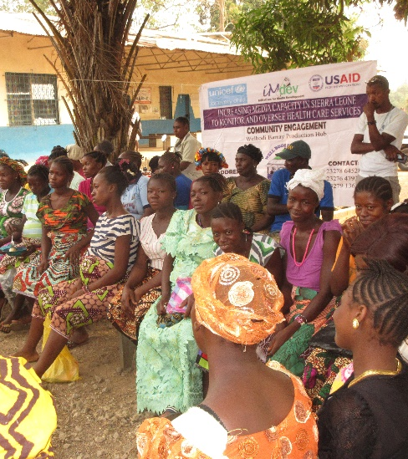
COMMUNITY OUTDOOR BROADCASTS
25 Community Outdoor broadcasts were held during the period under review.
The community outdoor broadcasts were planned and executed with the participating radio station in the host community and the District Health Medical Team.
Each outdoor broadcast as best practice aims to include but not limited to representation of the District Health Supervisor, Chief Health Officer in the community, Nurse, Health for All Coalition members, Village Development Committee member, Health Education District Extension worker, Local or Paramount Chief of the Community, Women and Youth Leader, Pregnant and lactating mothers, community-based organisations, the media and the general public.
https://drive.google.com/drive/folders/1HTOoaiWVTOS6Gh69bMs8geHwdyo6a5fF

Slide 10
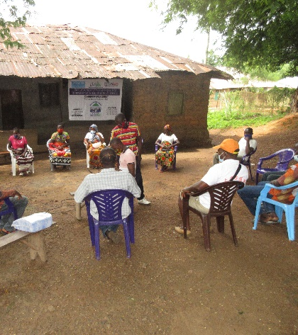
COMMUNITY OUTDOOR BROADCASTS
A town hall format in an open field/environment (this may include under a mango tree, court barray, or a town hall) is applied in all outdoor broadcasts creating the enabling environment for health authorities to account on issues emanating from the community.
This produced high level impact discussions at community level bringing to fore issues of payment for ‘free health care drugs and services’, the limitations and timeliness of supplies, what is considered free under the free health care scheme, the use of Traditional Child Birth attendants, the non-availability of ambulances and slow responses by the Community Health Canters and referrals to name a few.

Slide 11
COMMUNITY OUTDOOR BROADCASTS
HIGH IMPACT – COMMUNITY ENGAGEMENT
In the Waterloo Community in the Western Rural district, the use and relative trust in traditional birth attendants came to the fore. The community used the outdoor broadcast as an opportunity to discuss some of the factors that informs them for the choice of traditional birth attendants and home delivery. Economic and pragmatic reasons were raised as justification as delivery costs with a midwife or at health care facility were perceived unaffordable. The forum served as an opportunity for the community to be sensitised about the free health care highlighting the disadvantages of a home delivery under an unskilled traditional birth attendant.
In Makeni, Northern region, a lactating mother reported that she paid for delivery services and she had little or no information about the free health care. The information she received from the outdoor broadcast has enabled her to reach to her peers and community to sensitise them about the free health care and its related secondary benefits for women and children in Sierra Leone.
In Freetown, the capital city which has several opportunities to radio, television, newspapers and non-traditional methods of communication, women reported that drugs classified under the free health scheme are sold at Community Health canters, The Nurse in-charge justified that when they run out of drugs, nurses purchase drugs from pharmacies and sell at cost recovery prices to serve the patient needs.

Slide 12
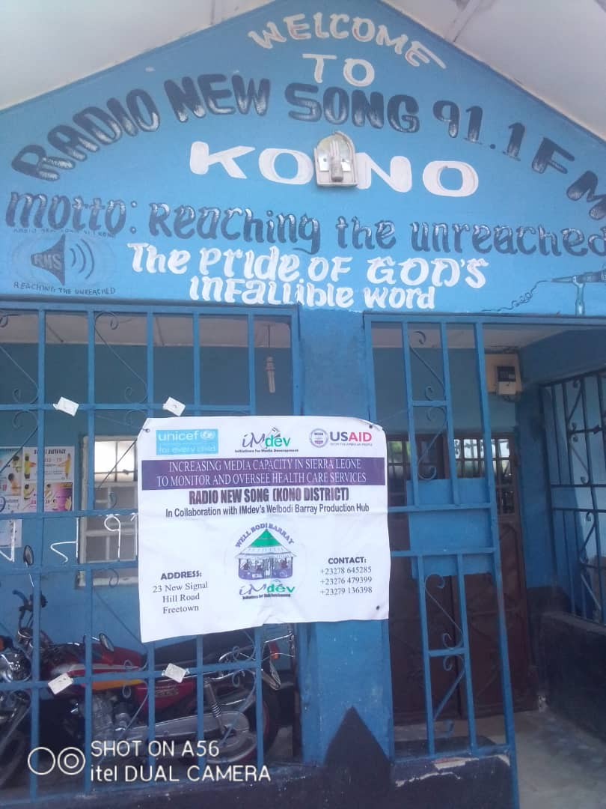
HEALTH ACCOUNTABILITY BROADCASTS
During the period under review, 30 non-state community radio stations were engaged. Memorandum of Understanding were developed between IMdev and the participating radio stations setting out the parameters of the partnership. https://drive.google.com/drive/folders/1cj1TyaowQ5n32O0Eac7wTkRlm36a8xEg
Each community radio station was tasked with identifying 2 journalists in their radio stations to produce local content and broadcasts in their radio stations on health accountability. The radio stations also agreed to broadcast national broadcasts developed by the IMdev Welbodi Barray production team.
By the end of the project, 25 national broadcasts were aired in all 30 community radio stations, and 125 local broadcasts were produced and aired.
https://soundcloud.com/user-445663626.

Slide 13
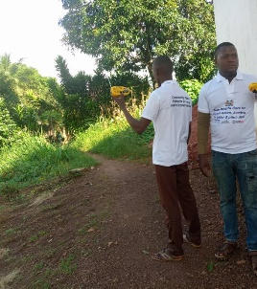
LISTENERS CLUBS
A small number of listener groups were piloted in the first phase of the project.
During this reporting period, these were scaled up to 30 listener groups and they provide constructive feedback on effective programme production and delivery.
The listener groups (6 for each group - male and female), were drawn from community stakeholders including chiefs, religious leaders, VDCs, mothers support groups, youths/children’s groups.
Feedback and tracking sheets for the listener groups were developed as a monitoring tool and all listener clubs members received training on its methodology. Solar radio handsets were provided to each member of the Listener clubs as an incentive for monitoring. The monitoring is voluntary.
https://drive.google.com/drive/folders/1W5sfM2qYNSxprPTgtL7vWTJq2pjdx8UE

Slide 14
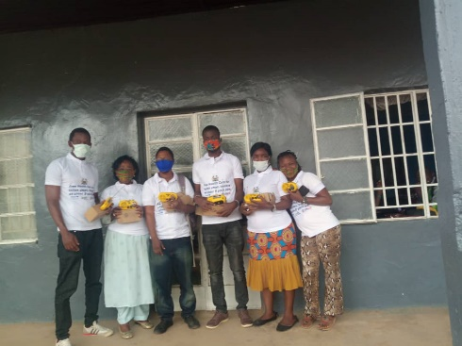
LISTENERS CLUBS
The listeners clubs provided feedback relevant to the content, timeliness and relevance to their respective communities.
WhatsApp groups were established by the Listeners coordinator for ease of communication for each Listening club. Through this medium broadcast schedules, recommendations, feedback and team dialogues are facilitated,
IMdev Welbodi barray production team benefitted immensely from the responses as it provided critical content evaluation and insights for the development of the next broadcasts.

Slide 15
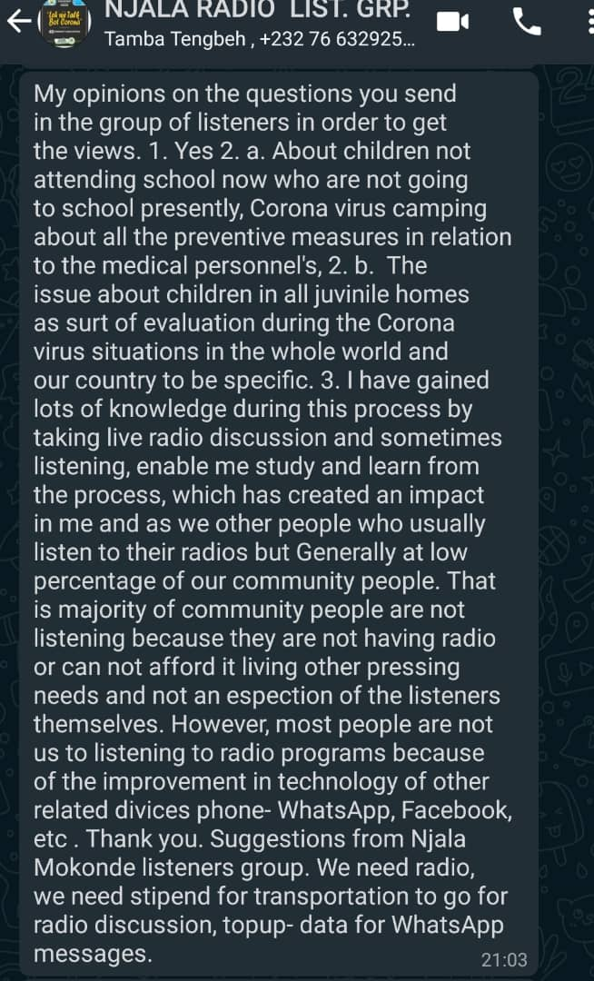

Slide 16
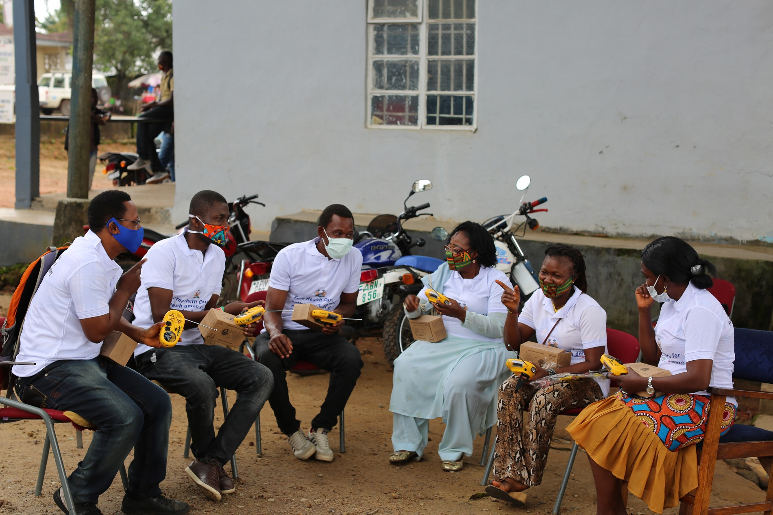
A listener club on receipt of the radio handsets

Slide 17
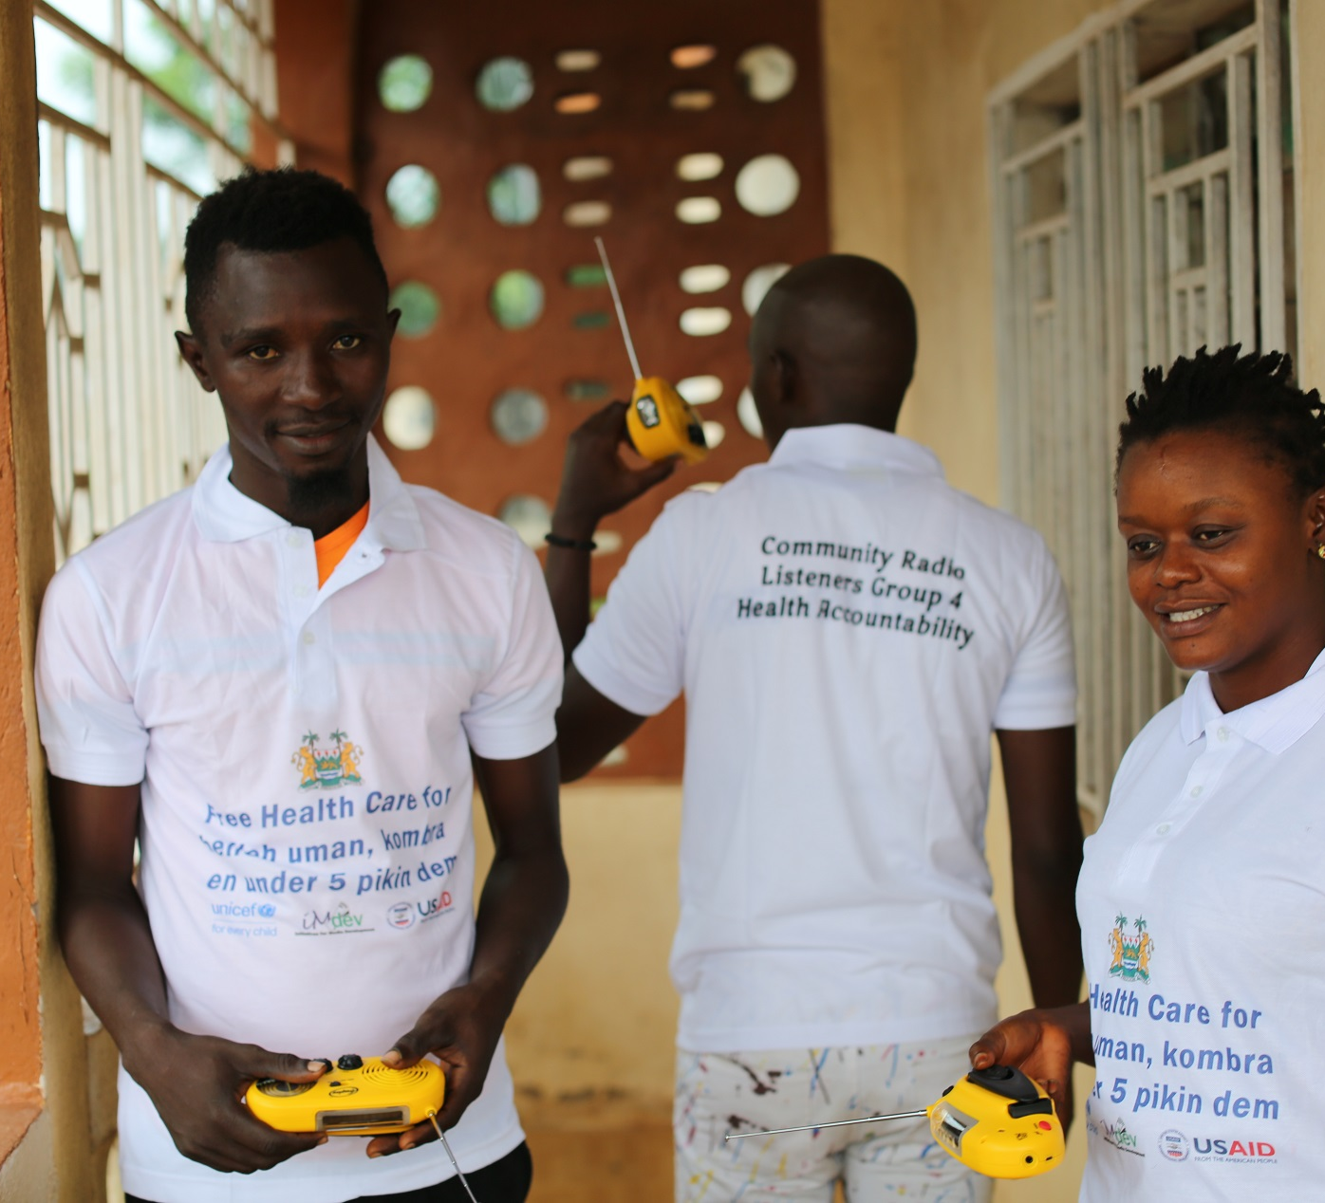
Happy listeners
Voluntary
Radio incentive
Our monitors - High impact low resources
Sustainable

Slide 18
SUCCESS STORIES
Sustainability of the Listeners clubs
IMdev is collaborating with the London School of Hygiene and Tropical Medicine in a study to assess the effects of Covid-19 and mitigation measures on women and children.
The objectives include assessing effect on incomes and livelihoods, SGBV, children's access to alternative learning during lockdowns and school breaks.
This is a longitudinal (cohort) study using a targeted panel of 900 women across the country.
The women will be recruited with the help of the 180 members of the Radio Listeners Clubs that are associated with our 30 community radio stations. A baseline survey will be conducted, and that will be followed by two other surveys (Panel Survey) at 3 monthly intervals.
The findings will inform improvement in the targeting of mitigation measures and generate knowledge on how to improve the protection of women and children now and during similar public health emergencies in the future
An application for funding had been made and response is pending. If funded, a full presentation will be made by Dr. Frank Baiden and IMdev to UNICEF and other partners

Slide 19

SUCCESS STORIES
NACOVERC has reached out to IMdev to work with the existing listeners clubs to monitor and feedback on Leh we fet Corona SLAJ/IRN broadcasts
IMdev is working on a concept to support UNICEFs sponsored Health Education projects in 60 community radio staions using 25 of the existing listeners clubs of the HA project. It is envisaged that 10 more will be set up in the respective communities.

Slide 20
CHALLENGES
Delays in the receipt of supplies
COVID-19 and its related impact on delays in programming and safety of journalists and staff
Access to Health Care personnel by HANoJ members
Limited access to Council meetings

Slide 21
RECOMMENDATIONS
The need for station managers and owners to receive training cannot be over emphasized. It’s the one possible way to influence editorial policies on the kind of stories that are carried in their media houses.
01
Community outdoor broadcasts have high impact with low resources. These direct engagements
02
Sustainablity of Listeners clubs in media interventions for monitoring and evaluation of UNICEF and UN partner projects.
03

Slide 22
Conclusion
152 HEALTH ACCOUNTABILITY NETWORK OF JOURNALISTS ESTABLISHED AND FUNCTIONAL
30 NON STATE COMMUNITY RADIO LOCAL WELBODI BARRAY PROGRAMS ESTABLISHED, SUPPORTED AND SUSTAINED WITHIN THE RADIO STATIONS
25 national health radio programs aired provided informative content on the status of i. the general health sector, and ii. holding health-related duty bearers and governance structures to account
125 community health radio programs aired provided informative content on the status of both i. the general health sector, and ii. holding health-related duty bearers and governance structures to account
30 listener clubs monitored and provided qualitative feedback on program content and reception.

